Slide 1
Systems of Linear Equations
Error Analysis
and
System Condition

Slide 2
Questions
What does it mean when a system of equations is ill-condition?
How can we tell if a system is ill-condition?
What can we expect from the solution when solving a system that is ill-condition?

Slide 3
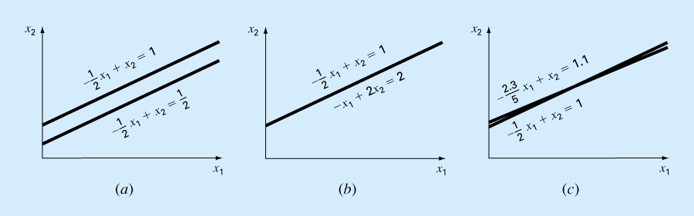
Ill-condition system
Singular (no solution)
Singular (infinite solution)
Ill-condition system (Near-singular)

Slide 4
Ill-condition System
Small change in input ➔ large change in output
For a system of equations, Ax = b, this means the result, x, will be very sensitive to
  Small changes in A
  Small changes in b
  Round-off errors introduced during the computation

Slide 5
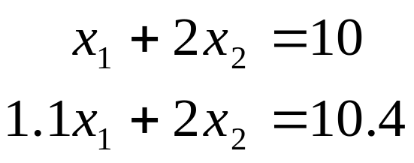
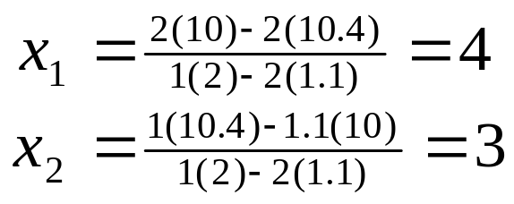
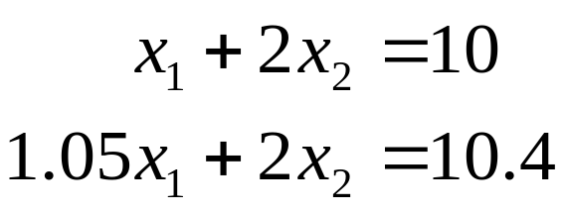
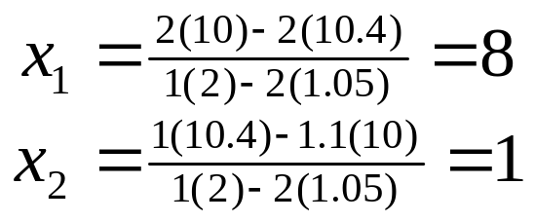
Example
An example of an ill-condition system and its solution
If we change the coefficient a₂₁ from 1.1 to 1.05, we have the equations and the corresponding solution as
That is, a small change in A results in large change in the solution!

Slide 6
Question
In general, when solving a system Ax = b, how can we tell how "reliable" the calculated result is?
The data may already have error during the data collection process.
We can't represent the data accurately.
Round-off errors are introduced during calculation.

Slide 7
Error Analysis
Suppose we want to find the solution of
Ax = b
Would there be a x' which gives b – Ax' ≈ 0 and yet x' is very different from the true solution?
Would a small rounding error in b or in A results in large change in the solution x?

Slide 8
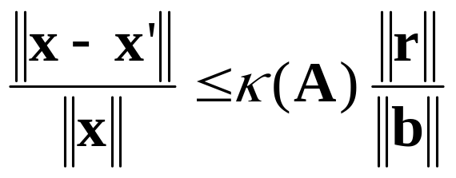
Relationship between error and residual
Suppose x' is the computed solution of Ax = b. Then
where
r = b – Ax' is the residual vector, and
κ(A) = || A ||·|| A⁻¹ || is the condition number of A.
|| · || is called the norm, which is a real-valued function that measures the size/length of vectors or matrices.

Slide 9
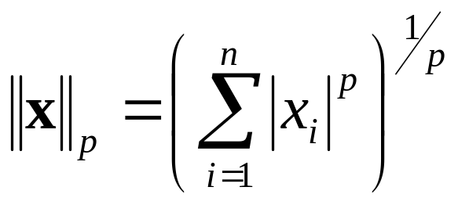
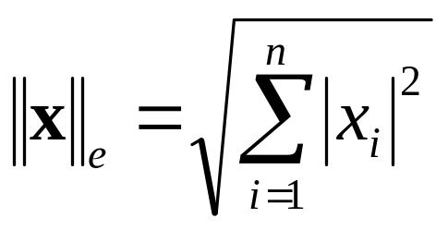
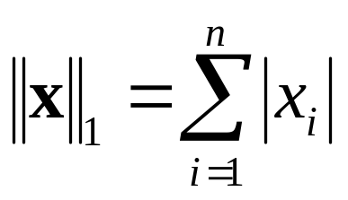
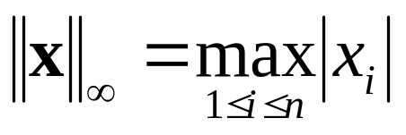
Various definitions of norm for Vectors
p-norm
Euclidean-norm
1-norm
∞-norm

Slide 10
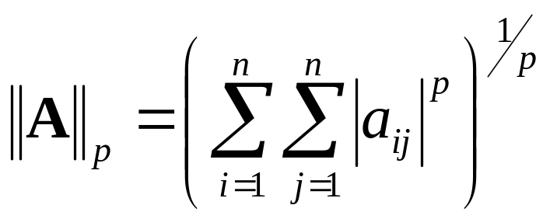
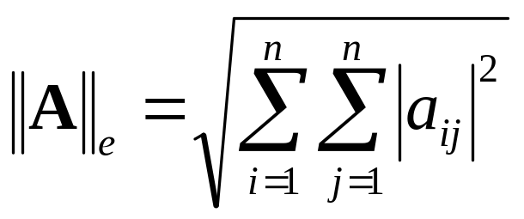
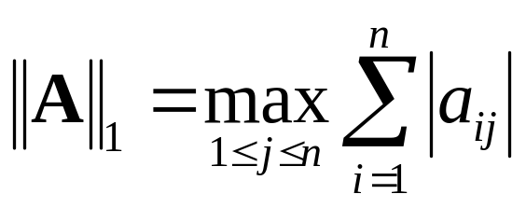
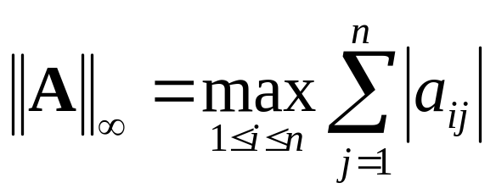
Various definitions of norm for Matrices
p-norm
Euclidean-norm
1-norm (max column)
∞-norm (max row)

Slide 11
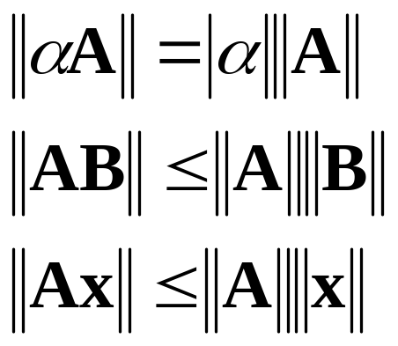
Some properties of norms and condition numbers
Condition number, κ(A) = ||A||||A⁻¹||
If A is non-singular, κ(A) ≥ 1

Slide 12
Error Analysis (Relationship between error and residual)
Suppose x' is the computed solution of Ax = b.
Let the residual be r = b – Ax' ---- (1)
Substitute b = Ax into (1) gives
r = Ax – Ax'
=> r = A(x – x')
=> x – x' = A⁻¹r
=> ||x – x'|| = ||A⁻¹r|| ≤ ||A⁻¹|| ||r|| ---- (2)
Thus, if ||A⁻¹|| is large, a small residual, r, may still result in large errors in the computed result.

Slide 13
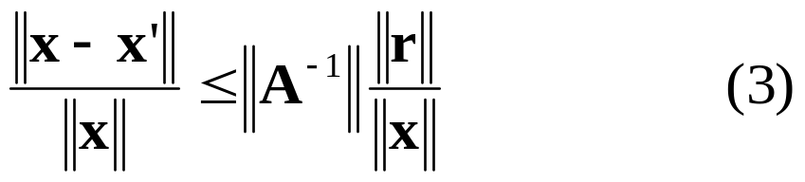
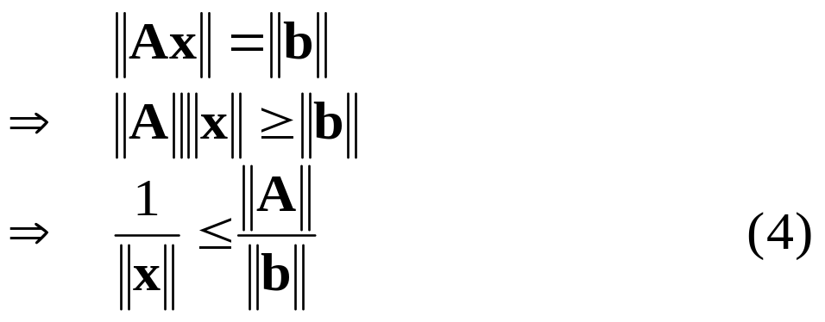
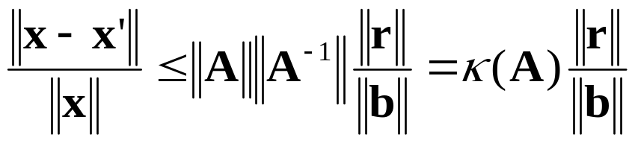
Error Analysis (Relationship between error and residual) [… continue]
To measure the relative error in the solution, we can divide (2) by ||x|| to get
Since Ax = b, it follows that
Substituting (4) into the R.H.S. of (3) gives

Slide 14
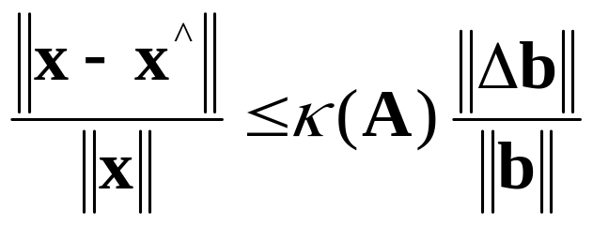
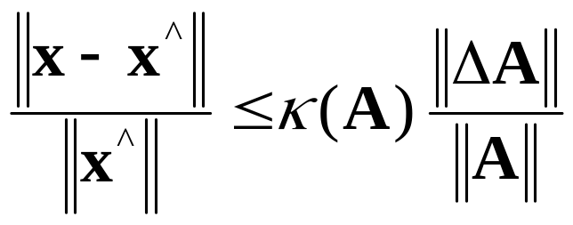
Relationship between the errors in x and the errors in b or A
Change in x w.r.t. change in b
Suppose Ax = b and Ax^ = (b+Δb), then
Change in x w.r.t. change in A
Suppose Ax = b and (A + ΔA)x^ = b, then

Slide 15
Error Analysis – Summary
The reliability of the solution depends heavily on the condition number of the matrix.
  e.g.: κ(A) = 10^{N} implies that the accuracy of the solution is reduced by about N decimal places.
Condition number is costly to calculate directly.
  For large systems of equations, condition number is estimated.

Slide 16
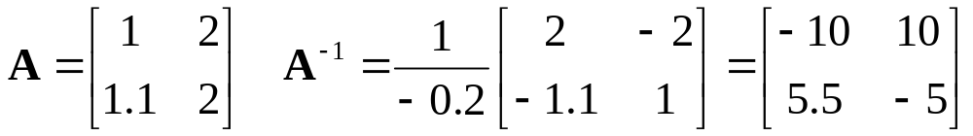
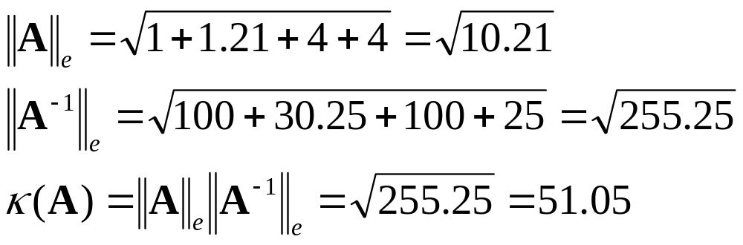
Excercise
Calculate κ(A) using 1-norm
Calculate κ(A) using Euclidean norm

Slide 17
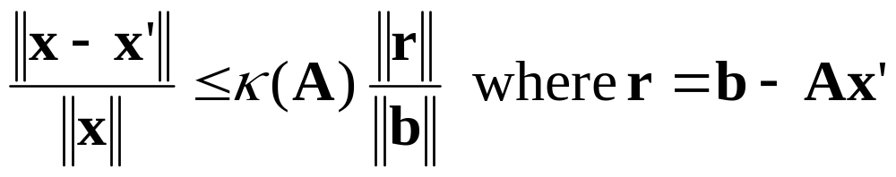
Iterative Refinement –
Residual Correction Method
Suppose the errors in A and b are negligible and the major errors in the solution are introduced during the computation.
Let x' be the computed solution. Then the inequality
suggests that we can improve the solution by reducing ||r||.

Slide 18
Iterative Refinement – Residual Correction Method
Suppose in solving Ax = b, we obtain the computed solution x' s.t. x = x' + ε.
Substituting x' back into the system yields
Ax' = b' ---- (1)
Ax = b => A(x' + ε) = b ---- (2)
(2) – (1) => Aε = b – b' = r ---- (3)
Solving the system of equations in (3) yieldsε.
By adding ε (called the correction factor) to x', we can possibly improve the solution to Ax = b.
The above procedure can be repeated if necessary.

